Slide 1
COMP 3069
Computer Graphics
Lecture 5:
Viewing
Autumn 2018

Slide 2
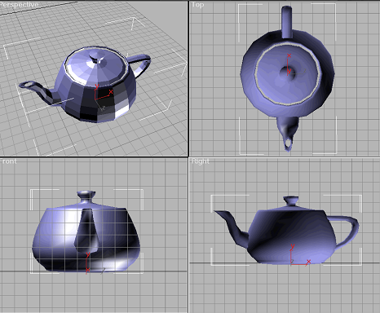
Transformation from World to View Space
Recap last week (animation)
Graphics coordinate systems
Virtual camera setup
World to View Transformation
An example transformation
A demo of camera setup
Coursework briefing
Coursework examples
Framework for the coursework
Notes:
3

Slide 3
Graphics Coordinate Systems
The geometry of objects is expressed in world coordinate system (or world space).
OpenGL by default creates an object centered at the coordinate origin of the world space, but you can specify the position of an object by giving exact x, y, z values for vertices,
E.g., glVertex(10, 20, 30)
Objects are then transformed to view coordinate system (or view space or camera space) so that they can be projected to the 2D image plane, analogous to taking a photograph with a camera.

Slide 4
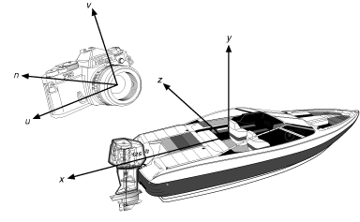
OpenGL Camera Setup – World to View Matrix
void Camera::SetUpCamera()
{
glMatrixMode(GL_MODELVIEW);
glLoadIdentity();
gluLookAt(
eye[0], eye[1], eye[2],
lookAt[0], lookAt[1], lookAt[2],
up[0], up[1], up[2]);
}
eye - camera position in world coordinate system
lookAt - camera viewing direction = lookAt - Eye
up - camera up direction

Slide 5
Changing Coordinate Systems
Suppose the world coordinate axes are in green and view (camera) coordinate axes are in red
The coordinate of a point (the black dot below) in world space is (5, 3). What’s the point’s coordinate in view space?
y
P(5, 3)
3
o
x
o
5

Slide 6
Given coordinates P in world space, how do we calculate coordinates P’ in view space?
This can be done by a transformation that aligns view coordinate axes with world coordinate axes:
  T to translate the view coordinate origin to world coordinate origin, then
  R to rotate to align view coordinate axes u, v, n with x, y, z of world space
  Then (RT) P = P’
y
y
V
N
U
V
x
N
U
x
z
z
Notes:
9
9

Slide 7
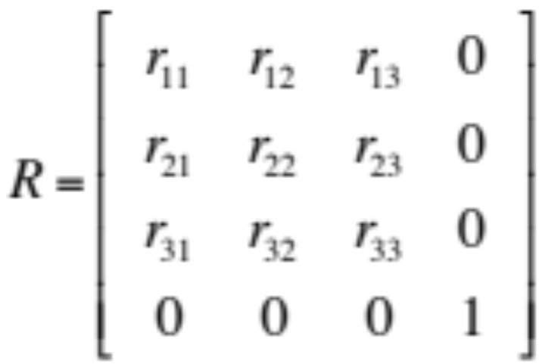
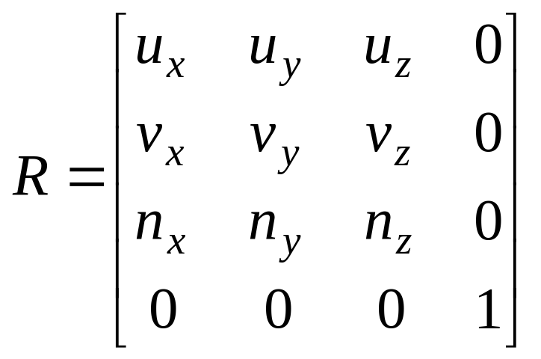
Rotation Matrix to Align View and World Coordinate Axes
World coordinate axes are
x = (x₁, x₂, x₃), y = (y₁, y₂, y₃), and
z = (z₁, z₂, z₃)
View coordinate axes are
u = (u_{x}, u_{y}, u_{z}), v = (v_{x}, v_{y}, v_{z}), and
n = (n_{x}, n_{y}, n_{z}),
We need to find a rotation matrix R to satisfy the following 3 simultaneous equations
x=R*u, y=R*v, z=R*n
Solving the 3 equations gives us

Slide 8
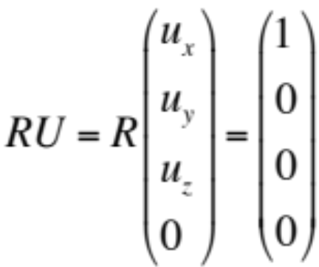
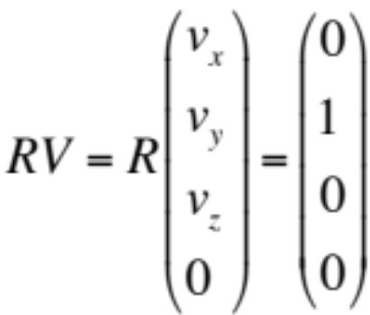
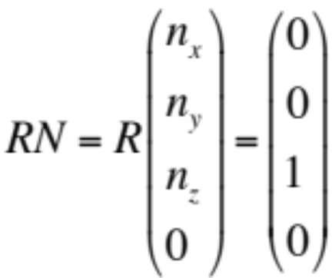
World to View Transformation – How?
So we want to find a rotation matrix R, such that:
Each green box represents 3 equations, that is, we get 3 equations from R * U = X, 3 equations from R * V = Y, and 3 equations from R * N = Z.
Equation solving omitted …

Slide 9
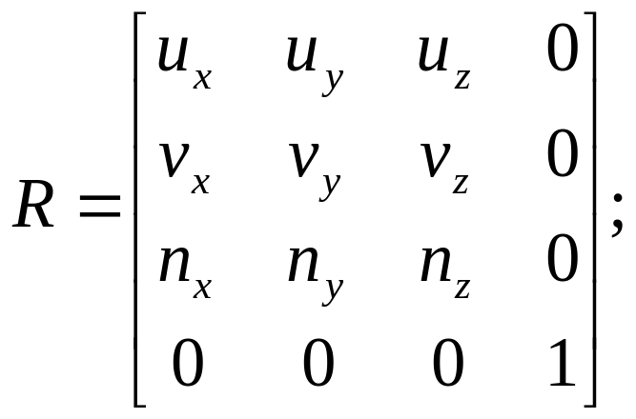
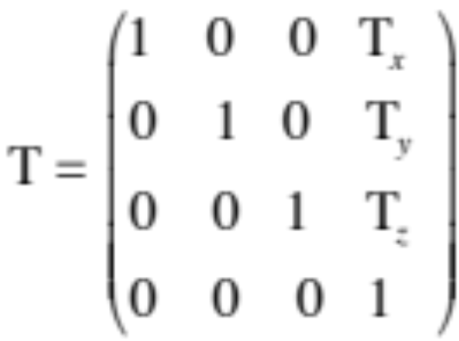
World to View Transformation
So if coordinate of a point in world space is P, and in view space is Q, then
P’ = R * T * P , and
T^{-1 *} R^{-1 *} P’ = P
where
y
V
N
U
P(5,4,2)
x
z

Slide 10
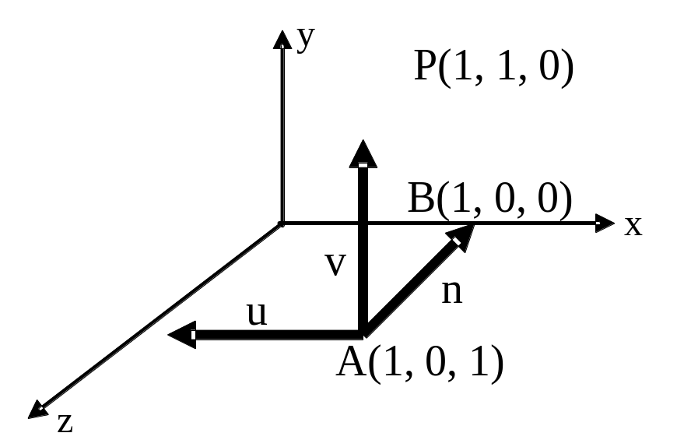
World to View Transformation Exercise
A viewing coordinate system is set up with the eye at A(1,0,1), lookat at B(1,0,0), and 'up' vector is the positive y direction.
P is a point in world coordinate system. Derive an expression that gives P’s coordinates in the view coordinate system.
Solution will be given in
the lecture
u = -x
v = y
n = -z

Slide 11
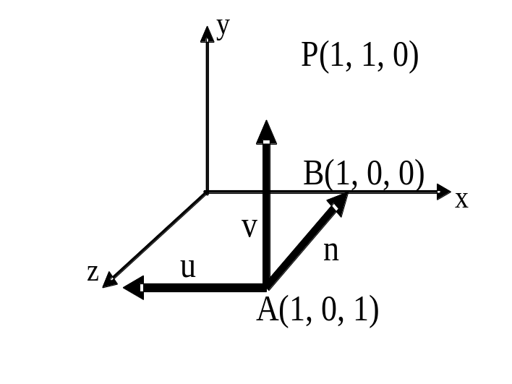
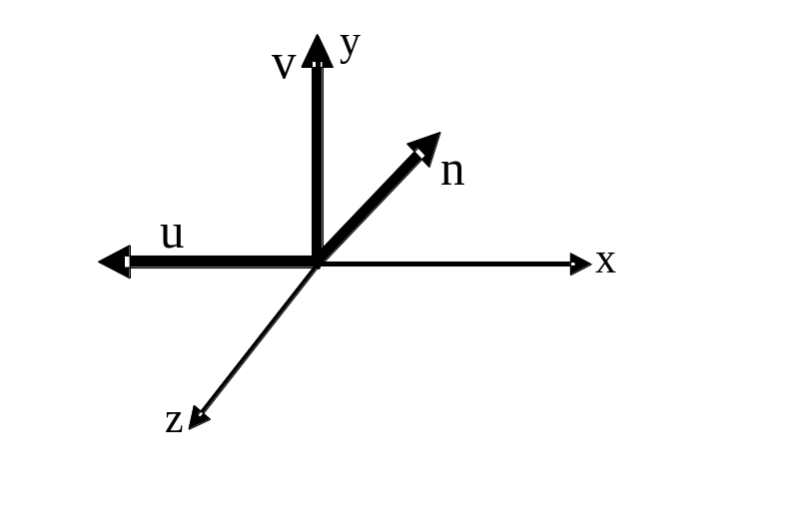
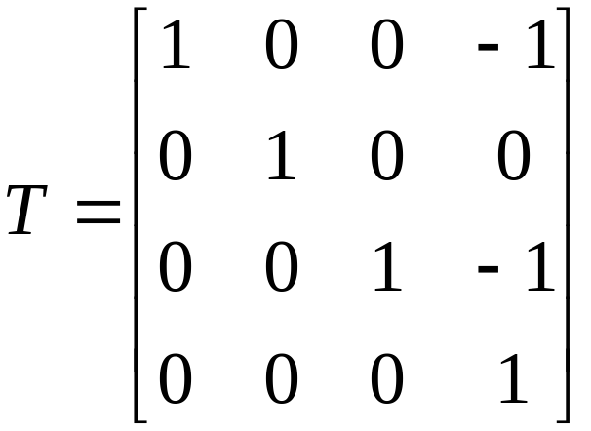
World to View Exercise
First translate the camera center to the origin
Translation matrix:
Translate by
(-1, 0, -1)

Slide 12
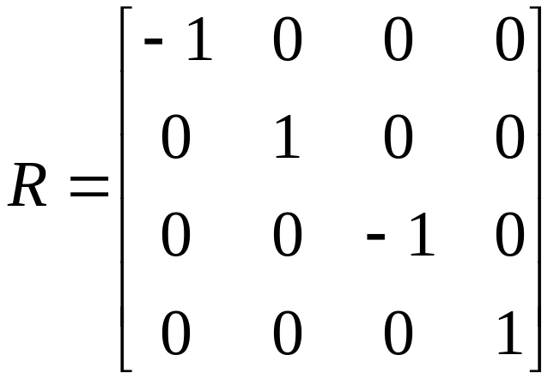
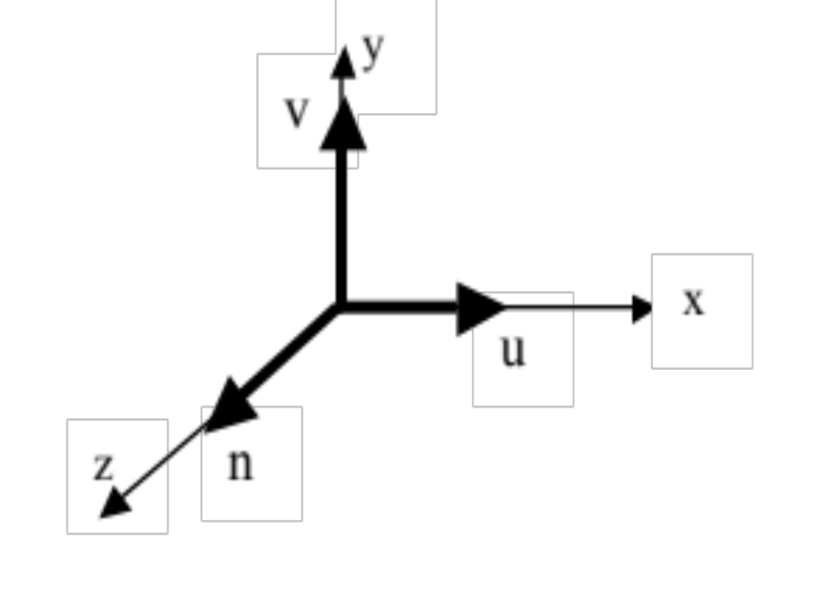
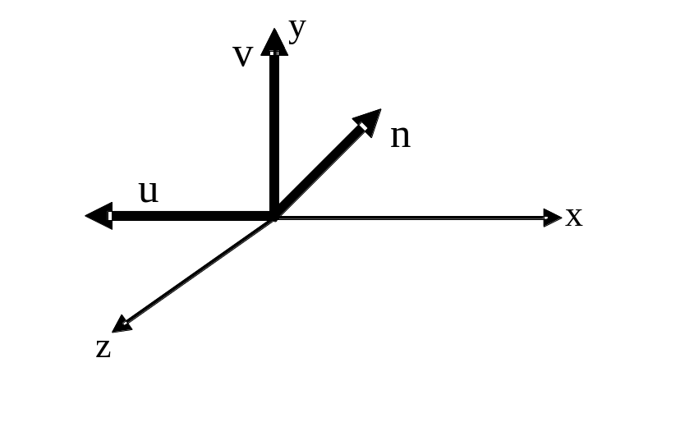
World to View Exercise
Then rotate to align the axes:
As u = (-1, 0, 0), so
v = (0, 1, 0),
n = (0, 0, -1)
Rotate by R

Slide 13
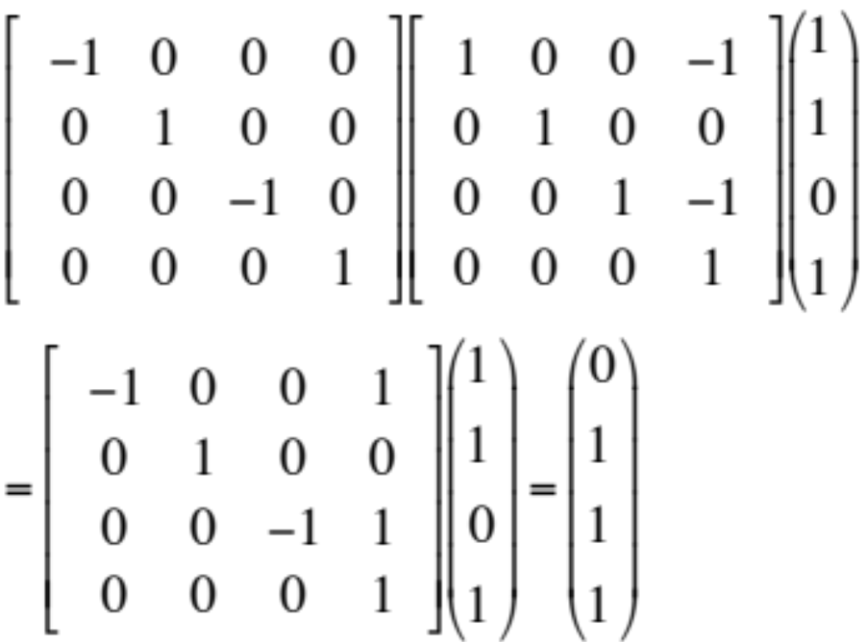
World to View Exercise
R
T
P
So a point P in world space,
can be transformed to view
space by a translation (T)
and then by a rotation (R):
Q = R T P

Slide 14
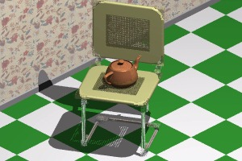
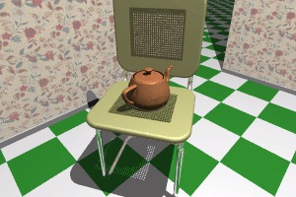
Projecting 3D objects onto Camera Image Plane (View Plane) – Next Week
Now our objects / 3D world is in the
view/camera coordinate system, ready to be projected onto 2D camera image plane or view plane.
P(u,v,n)
v
P(u_{p},v_{p,},n_{p})
d
o
-n
u

Slide 15
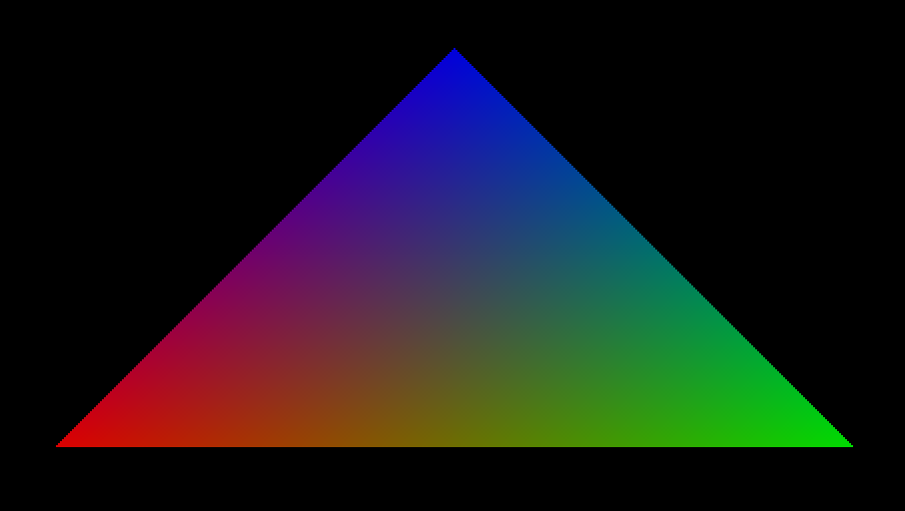
The Viewing Demo –
Creating a Triangle Object
glBegin(GL_TRIANGLES);
glColor3ub(255, 0, 0);
glVertex3d( -40, -00, 0.0 );
glColor3f(0, 1.0, 0);
glVertex3d( 40, -00, 0.0 );
glColor3ub(0, 0, 255);
glVertex3d( 0.0, 40, 0.0 );
glEnd();
How do you set up the camera to view the triangle?

Slide 16
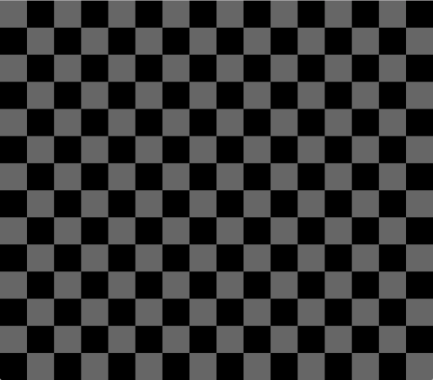
The Viewing Demo –
Creating a Floor Object:
for(int i = -10; i <= 10; i ++) {
for(int j = -10; j <= 10; j ++) {
…
glBegin(GL_QUADS);
glVertex3f( S*(float) i, -10.0f, S*(float) j);
glVertex3f( S*(float) i, -10.0f, S*(float) j + S);
glVertex3f( S*(float) i + S, -10.0f, S*(float) j + S);
glVertex3f( S * (float) i + S, -10.0f, S * (float) j);
glEnd();
} ***S is short for SIZE***
}
How do you set up the camera to view the floor?

Slide 17
Coursework Briefing
It is time to think about your coursework
As mentioned in the introduction lecture, the coursework is about implementing a graphics application, of your choice
Think about what you’d like to do, e.g.,
  What you would like to model and/or animate
  How you could make use of what you have learnt for your coursework
  Write down your ideas and discuss your ideas with your peers, tutors, or lecturer

Slide 18
